Slide 1


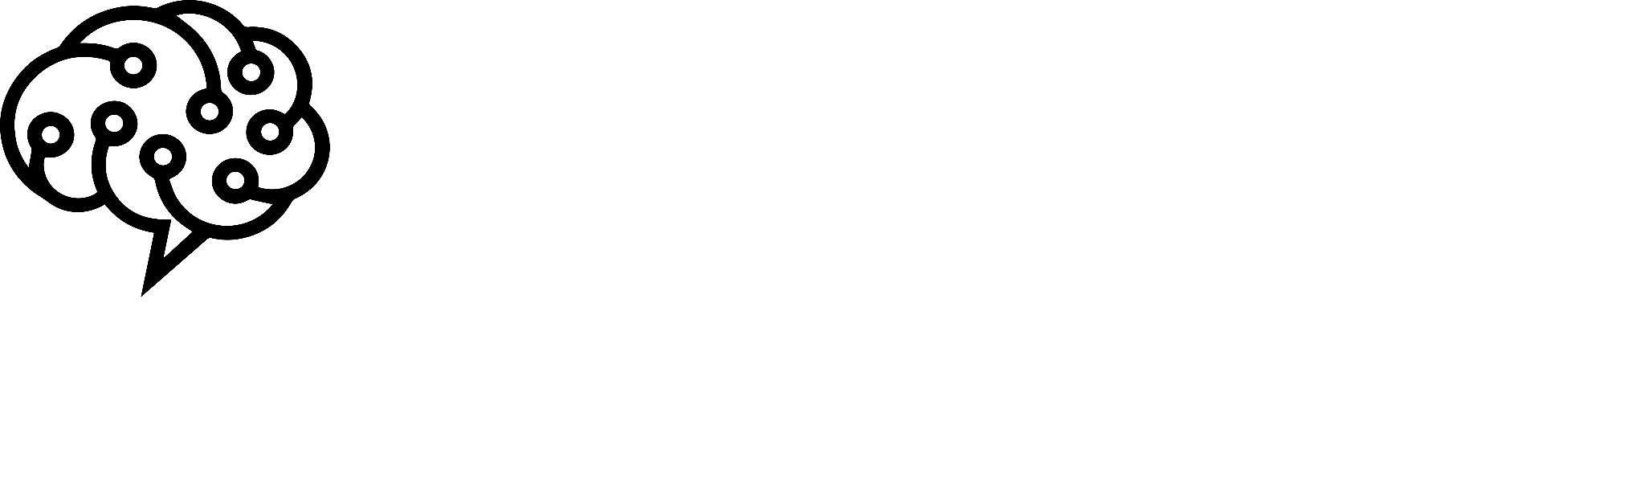
Hello and Welcome to
AI Camp

Slide 2
YOLO for image recognition
BOUCHOUCHA Mohammed El Amine
BOUMEDINE billal

Slide 3

Table of index
Evolution of Computer Vision techniques.
YOLO: The new way of doing CV.
Prediction phase.
Training phase.
Architecture of the model.
Practise

Slide 4


Evolution of CV techniques

Slide 5
Evolution of CV techniques
Handcrafted filters.
Learning parameters of filters.
Image segmentation and advanced model’s pipelines, DPM, R-CNN, mainly using Sliding windows techniques.
2013: R-CNN: Region proposal => Feature extraction => SVM.
Fast R-CNN, Faster R-CNN.
The new way of doing Computer vision: YOLO.
Check appendix for more detailed historical sequence of events

Slide 6
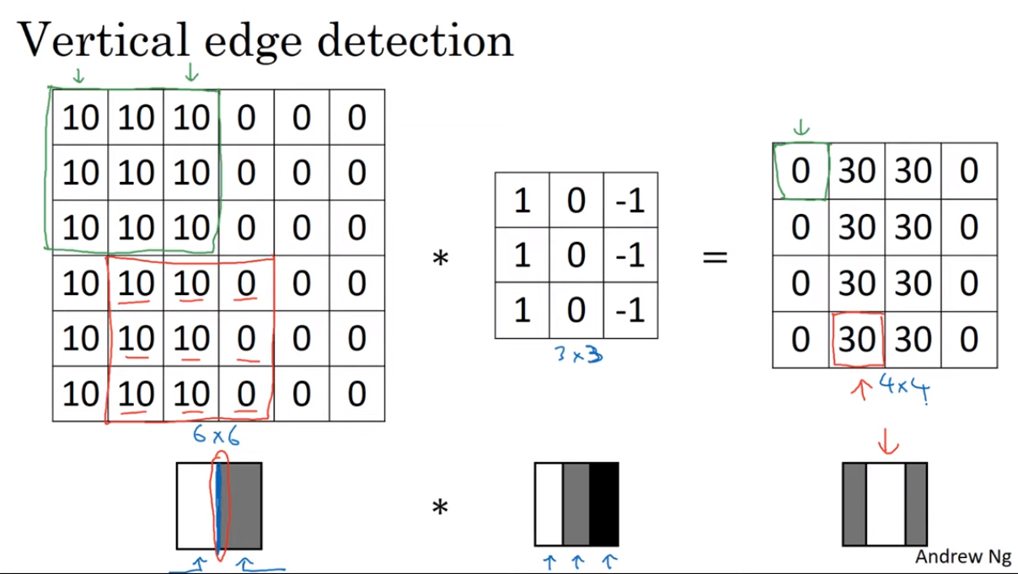
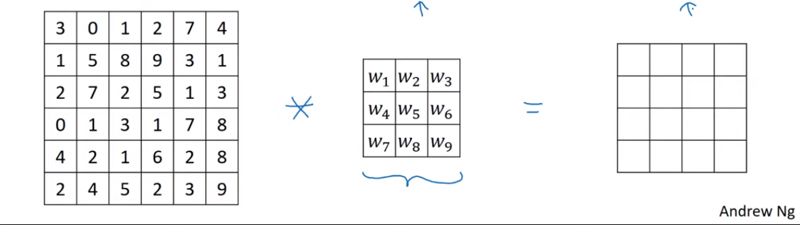
Handcrafted filters: We have some mathematically based kernels to do detection, some other kernels are: Sobol and Schar, these are mainly used for simple computer vision tasks.
Learning filters features:
Used to detect different edge structures, so that our kernels learn to extract the right data.
Convolutional Neural Networks (Course 4 of the Deep Learning Specialization)

Slide 7
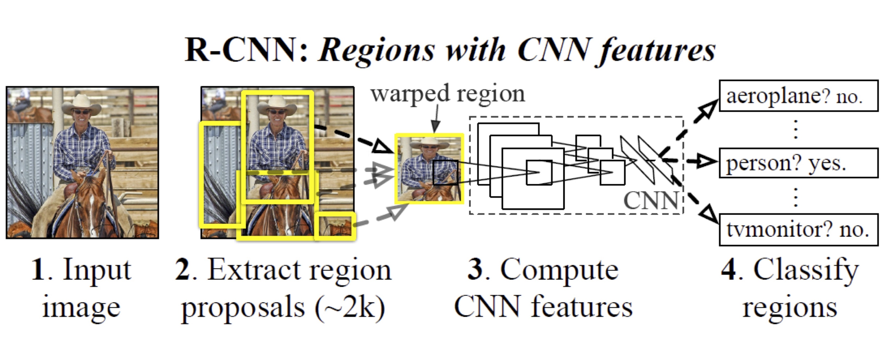
Region based models:
this technique was developed due to the limitations of simple CNN to work on complexe pictures, we had then FAST R-CNN, FASTER R-CNN, which aimed to optimize the stages of the pipeline check this article for more information: link.
Girshick, R., Donahue, J., Darrell, T., & Malik, J. (2013). Rich feature hierarchies for accurate object detection and semantic segmentation. arXiv preprint arXiv:1311.2524 [cs.CV]
R-CNN:
Multi stage technique.
Algorithmic based region extraction.
Window sliding on regions, some other models that used this technique.
Limitations:
Multi stage pipeline.
Computation efficiency.
Real time object detection.
Different scale and aspect ratio.

Slide 8
YOLO
The new way of doing Computer vision

Slide 9
The new way of doing Computer vision, YOLO: You Only Look Once
Since using window sliding method wasn’t efficient in term of computation.
YOLO model does only look once to the entire picture.
How ? YOLO takes the entire image as input no sliding window.
Problem: The sliding window was designed to run the model for each part of the image since processing the entire image is complex for simple CNN,
So without sliding windows what are we going to solve this problem for complex images ?
"You Only Look Once: Unified, Real-Time Object Detection" by Joseph Redmon, Santosh Divvala, Ross Girshick, and Ali Farhadi (arXiv:1506.02640) - Introduces the YOLO (You Only Look Once) approach for real-time object detection.

Slide 10
The solution to this problem is dividing the image to grid cells ( equal boxes ).
And for each grid cell we find the Bounding boxes which their center is in the cell.
We Choose one bounding box per grid cell using the non-max suppression technique.
Then one class per bounding box. ( YOLOV1 )
But How can YOLO process all boxes in parallel and still perform very fast ?
It’s due to its architecture layers of convolution, Loss computation for training.

Slide 11
Prediction phase

Slide 12
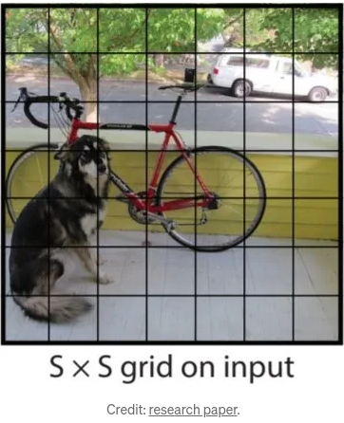
Dividing the image to grid cells ( equal boxes ).

Slide 13
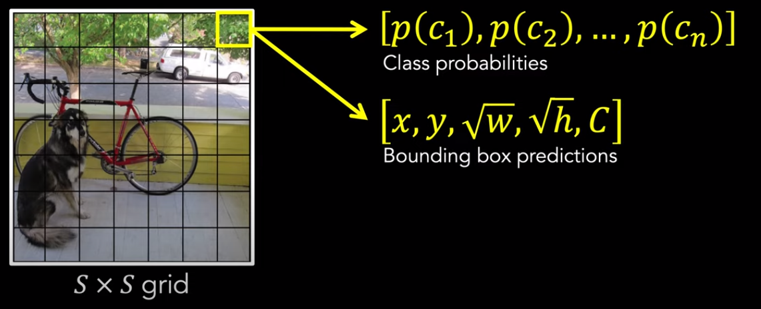
And for each grid cell we find the Bounding boxes which their center is in the cell.

Slide 14
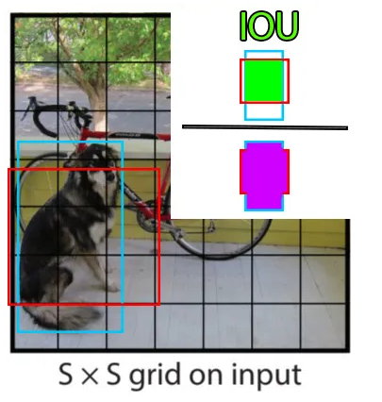
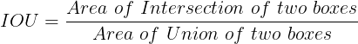
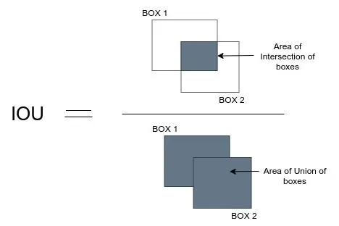
We Choose one bounding box per grid cell using the non-max suppression technique:
If IOU > Threshold: Take the box with biggest confidence.

Slide 15
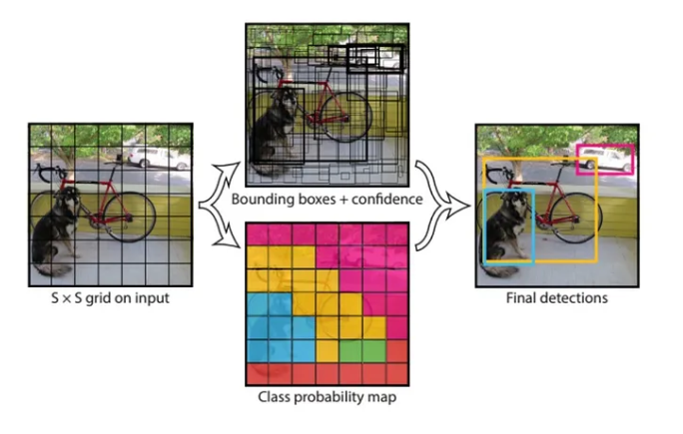
Then one class per bounding box: the final confidence of prediction is the probability of the class multiplied by C.

Slide 16
Training phase

Slide 17
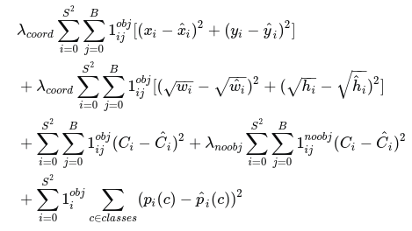
Input: Image
Output: Vector [C,Bx,By,Bw,Bh,P(C1),P(C2),...,P(Cn) ]*B
B is number of boxes
Loss Function: Total Loss=λ coord.Coordination Loss+λ conf.Confidence Loss+λ class.Class Loss

Slide 18
Localization Loss (L_coord):
Measures the error in predicting the bounding box coordinates (x, y, w, h) relative to the ground truth.
mean squared error (MSE).
Confidence Loss (L_conf):
Represents the confidence of the model in predicting an object within a bounding box. ( binary cross-entropy )
Classification Loss (L_class):
Measures the error in predicting the class probabilities for each bounding box. (categorical cross-entropy loss)

Slide 19
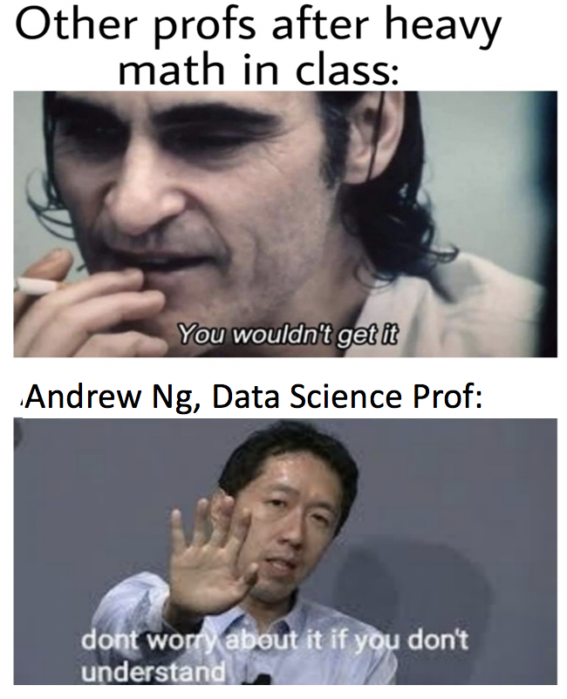

Slide 20
Architecture of the model

Slide 21
Backbone: CNN that is responsible for extracting hierarchical features from the input image. Common choices for the backbone architecture include Darknet-19 or Darknet-53, which are variants of the Darknet architecture.
Neck: Same as Backbone ( Optional ).
Head: The head is the final part of the YOLO architecture and is primarily responsible for predicting bounding boxes and class probabilities. Comprising several convolutional layers and fully connected layers.
These predictions include the coordinates of bounding boxes (center, width, height) and associated class probabilities for objects within the image.

Slide 22
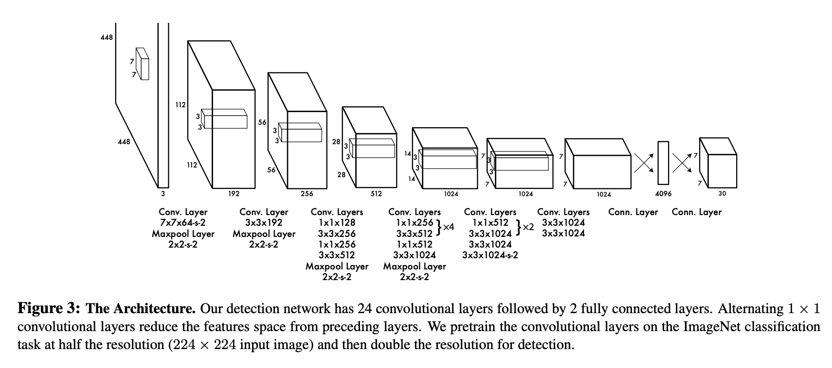
https://opencv-tutorial.readthedocs.io/en/latest/yolo/yolo.html

Slide 23
Practise

Slide 24
Let’s do some coding
https://opencv-tutorial.readthedocs.io/en/latest/yolo/yolo.html

Slide 25
Appendix

Slide 26
Appendix - A
Handcrafted filters:
Years: Pre-1990s
Research Paper: While there might not be a single specific paper, early works in computer vision involved handcrafted filters for edge detection and image processing. Papers like "Computer Vision: Algorithms and Applications" by Richard Szeliski (2010) provide an overview of classical techniques.
Learning parameters of filters:
Years: Late 1990s - Early 2000s
Research Paper: "Gradient-Based Learning Applied to Document Recognition" by Yann LeCun, Léon Bottou, Yoshua Bengio, and Patrick Haffner (1998) - This paper introduced the concept of learning parameters in convolutional neural networks for handwritten digit recognition.
Image segmentation and advanced models: DPM, R-CNN:
Years: Early to mid-2010s
Research Papers:
"Object Recognition from Local Scale-Invariant Features" by David G. Lowe (2004) - Introduces SIFT, which became a key component in later methods.
"Deformable Part Models are Convolutional Neural Networks" by Ross Girshick, Forrest Iandola, Trevor Darrell, and Jitendra Malik (2015) - This work discusses the DPM model.

Slide 27
Appendix - A
R-CNN:
Year: 2013
Research Paper: "Rich feature hierarchies for accurate object detection and semantic segmentation" by Ross Girshick, Jeff Donahue, Trevor Darrell, and Jitendra Malik (arXiv:1311.2524) - Introduces the R-CNN approach.
Fast R-CNN, Faster R-CNN:
Years: 2015 (Fast R-CNN), 2016 (Faster R-CNN)
Research Papers:
"Fast R-CNN" by Ross Girshick (2015) - Describes the Fast R-CNN architecture.
"Faster R-CNN: Towards Real-Time Object Detection with Region Proposal Networks" by Shaoqing Ren, Kaiming He, Ross Girshick, and Jian Sun (2016) - Introduces Faster R-CNN with an integrated region proposal network.
YOLO: You Only Look Once
Year: 2016
Research Paper: "You Only Look Once: Unified, Real-Time Object Detection" by Joseph Redmon, Santosh Divvala, Ross Girshick, and Ali Farhadi (arXiv:1506.02640) - Introduces the YOLO (You Only Look Once) approach for real-time object detection.

Slide 28
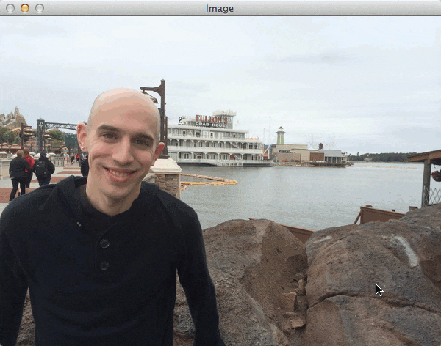
Appendix - B
Sliding Window Algorithm:
it is used in these Computer vision techniques:
Histogram of Oriented Gradients, Integral Channel Features, Cascade Classifier (Viola-Jones), Deformable Part Models.
https://pyimagesearch.com/2015/03/23/sliding-windows-for-object-detection-with-python-and-opencv/

Slide 29
Thank you for attending
any questions ?

